Slide 3
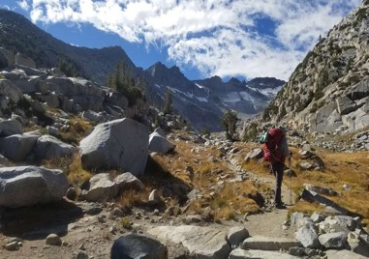
mi esposa
mi perros

Slide 4
Provide transformative travel experiences

Slide 6
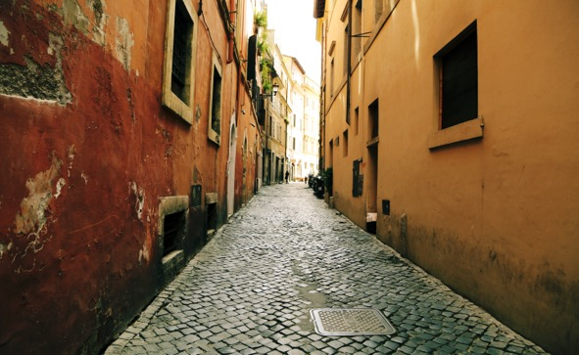
Carefully Crafted
Unique Experiences

Slide 7
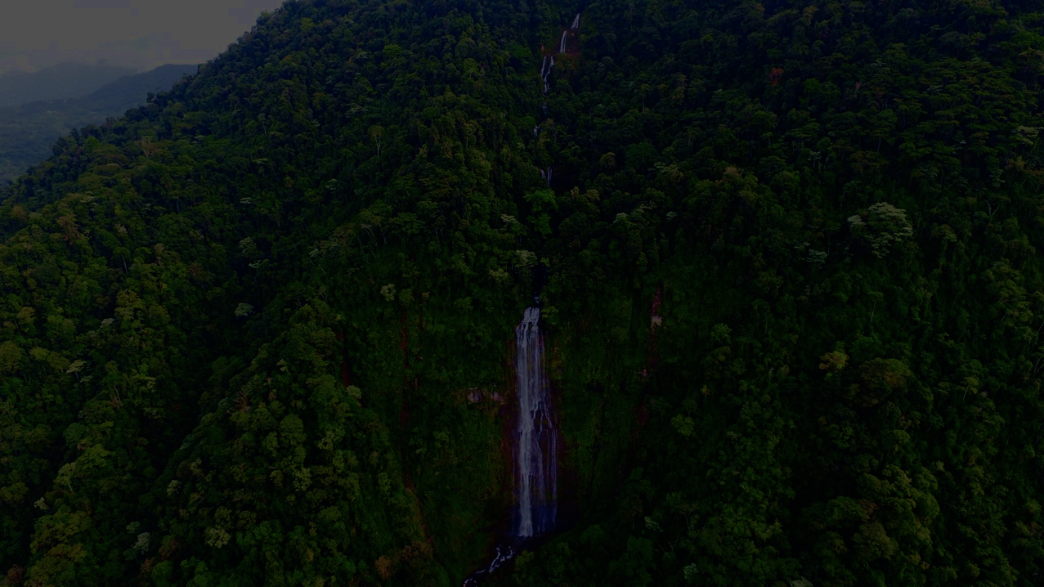
COSTA RICA
Notes:
Finding these BTM experiences is often an adventure in of itself- one full with unsuspecting twists and turns. This evening I would like to share with you our journey that led us to discovering our beyond the map experience in Costa Rica.
But first for those of you that may not know much about the area, it will help to know where it is…does anyone know? (stickers)

Slide 8
WHAT ARE YOU MOST EXCITED FOR?
WHAT ARE YOU MOST NERVOUS ABOUT?
WHAT INSPIRED YOU TO GO TO COSTA RICA?

Slide 9
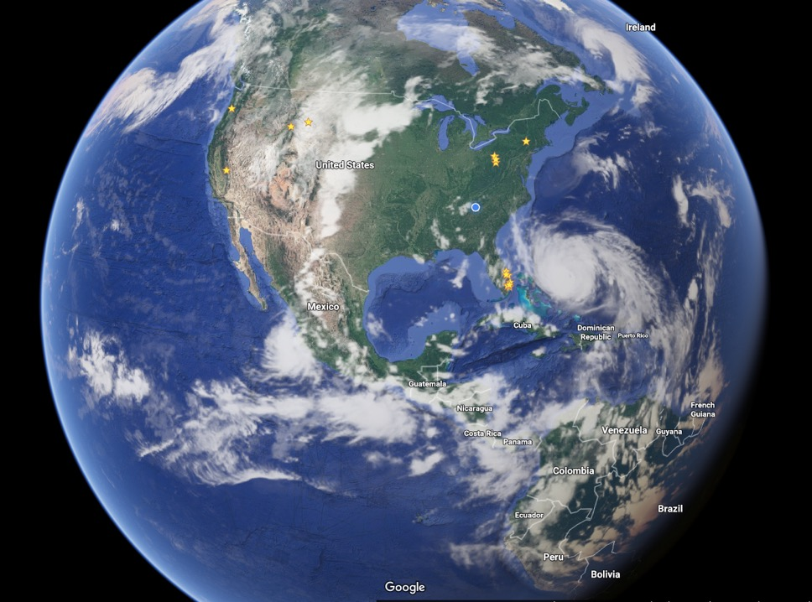
TRAVEL NOTES:
< 3 Hrs (from FTL)
-2 hr time change
9º 56' N, 84º 05' W

Slide 10
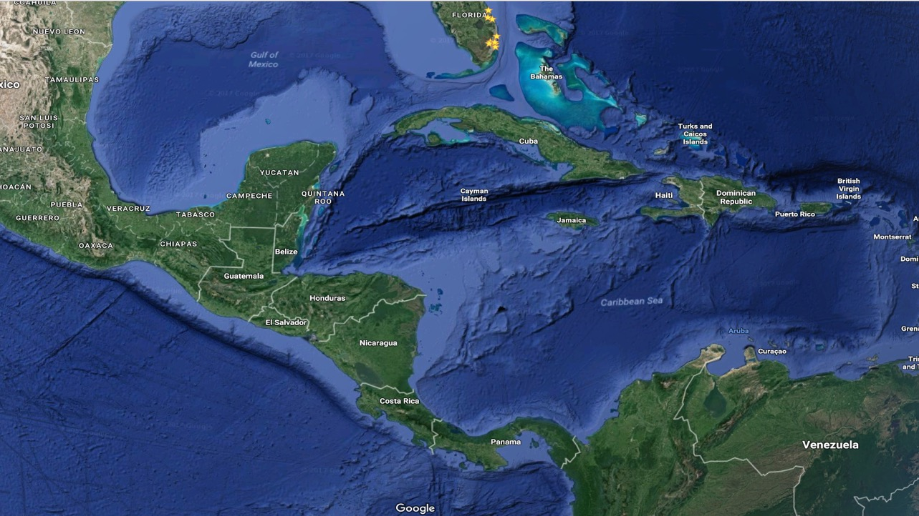

Slide 14
Leaf Cutter Ants
White Faced Capuchin
Eyelash Pit Viper
Keel-Billed Toucan
Blue Morpho
3-Toed Sloth
Bark Scorpion
Quetzal

Slide 15
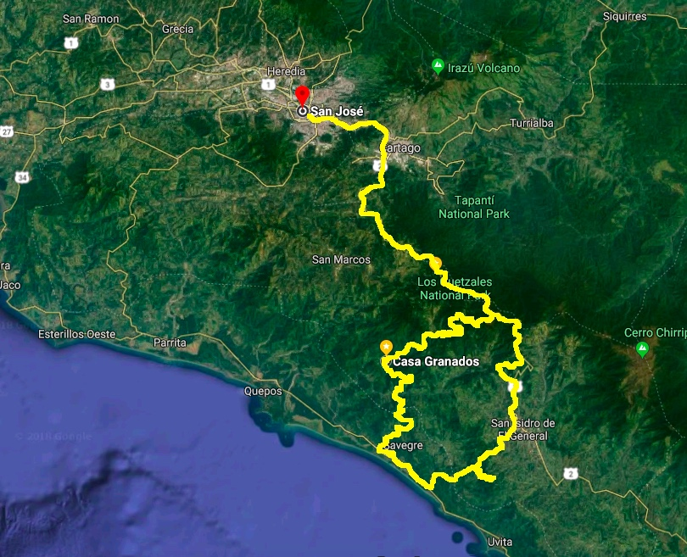

Slide 16
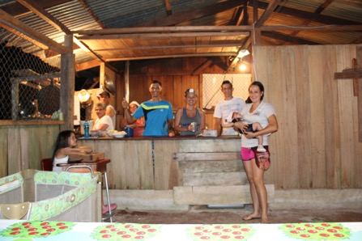
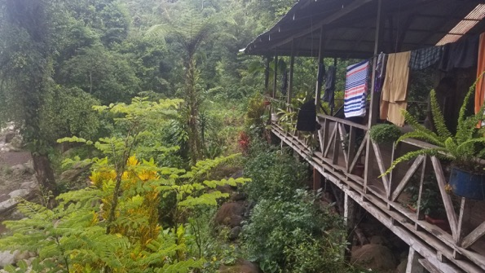
DAY 1
Travel day = 3 ½ - 4 hr drive
Rustic ranch & farm
Dinner, welcome & orientation
Relax, you’ve made it!

Slide 17
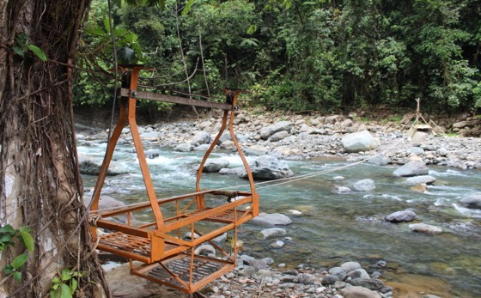
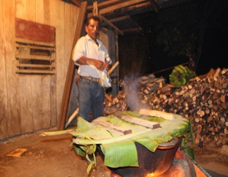
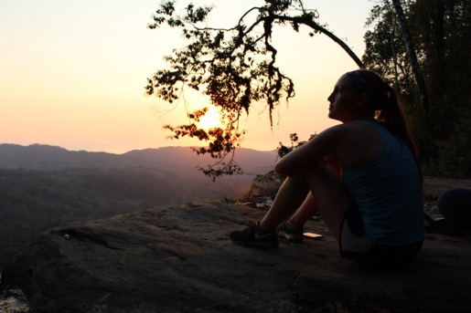
DAY 2
1 hour hike to remote village
Explore village & surrounding area
Locally prepared lunch
Afternoon community service project
Homestay with local family (rustic)
Prepare and learn local dishes for dinner with the family
Relax to the sounds of the jungle!

Slide 18
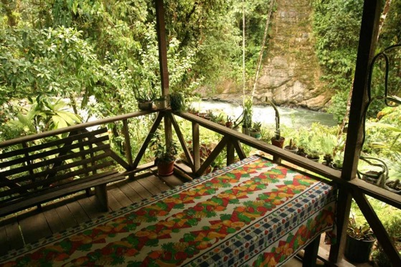
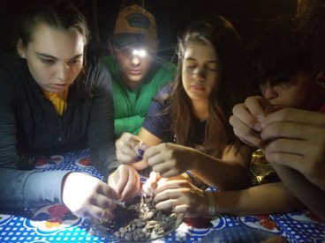
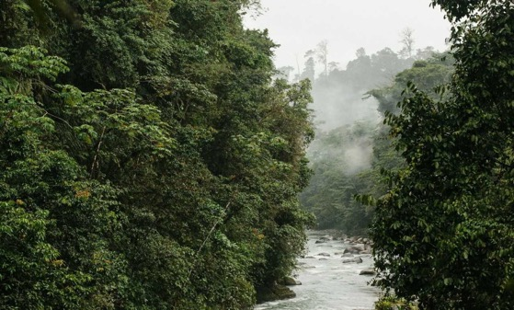
DAY 3
1 hr hike to next homestay
Explore local area and river
Lunch and afternoon community service project
Traditional sauna ceremony and swimming
Dinner and chocolate making

Slide 19
DAY 4
Hike out of the jungle towards the coastline
Lunch on the Pacific Coastline
Learn to surf on world-class waves
Final group dinner before returning home

Slide 20
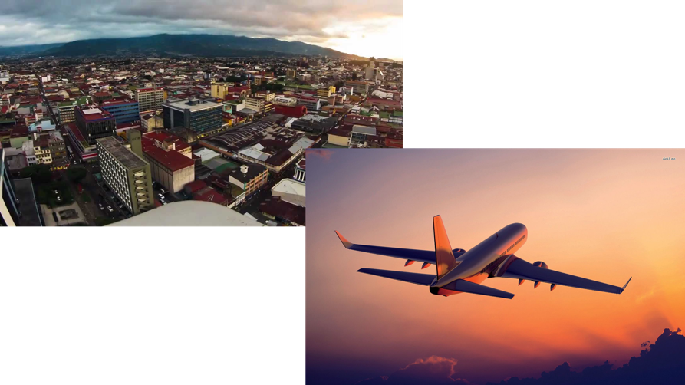
DAY 5
3-4 hr drive
Lunch & souvenirs
Depart for home!

Slide 21
QUESTIONS??

Slide 22
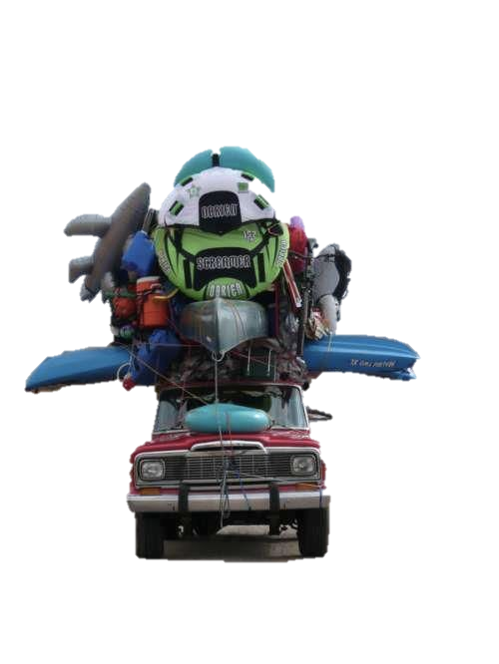
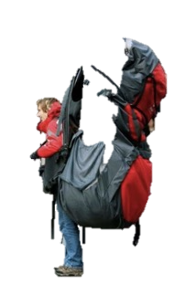
Travel Notes:
Accommodations:
”Natural” Air Conditioning
“Natural” Showers
No/Limited Electricity
Luggage
Cell-phones
“WILD” life

Slide 23
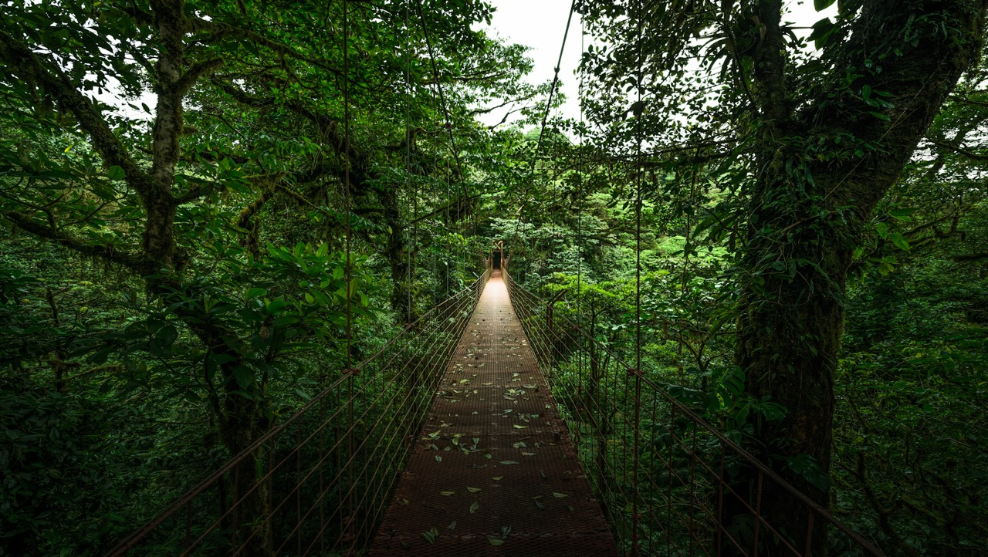
PACKING LIST

Slide 24
Can't Live Without
Duffel Bag/Suitcase
Base Layers (moisture wicking)
T-shirts/Long Sleeves
Pants/shorts
Rain Jacket & Rain Pants
Hiking Boots/Athletic Shoes
2nd Pair of Comfort Shoes
Sweater/Hoodie
Undergarments
Swimsuit
Toiletries
Passport/ID
Personal Medications
Day pack/backpack
Can Barely Live Without
Watershoes (secure)
Sunglasses/Croakies
Camera, Batteries, Chargers
Headlamp (BTM Rental Available)
Trekking Pole
Towel
Journal/Book
Re-Usable Water Bottle
Insect Repellent
Colon (local currency)
Plastic Bag(s) for Dirty/Wet clothes
Dry Bag
Ear Plugs

Slide 25
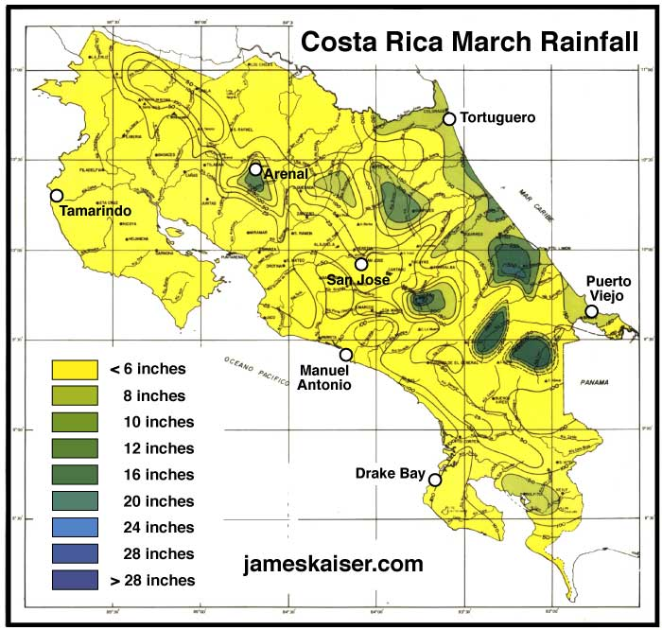
WEATHER
Dry Season
Coastal temps: low 80’s to low 90’s
Highland temps: mid 70’s to mid 80’s
Generally, warmest time of the year…

Slide 26
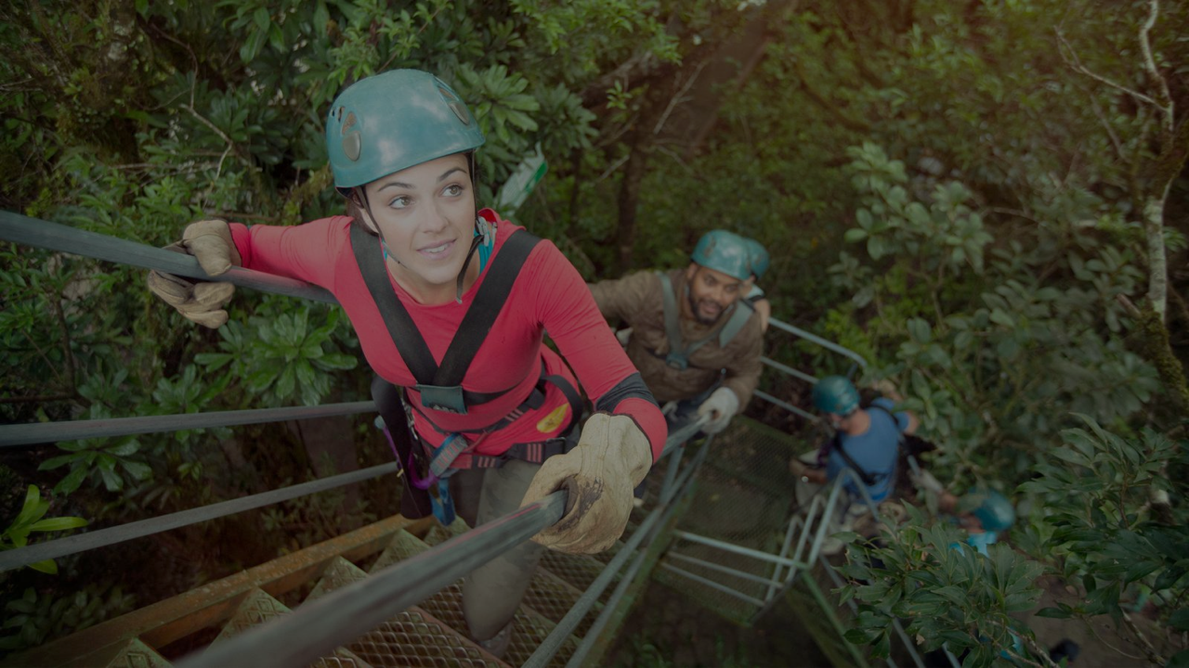
SAFETY
Follow the packing list
Follow instructions
Be Alert

